Slide 1
Data Types in Java

Slide 2
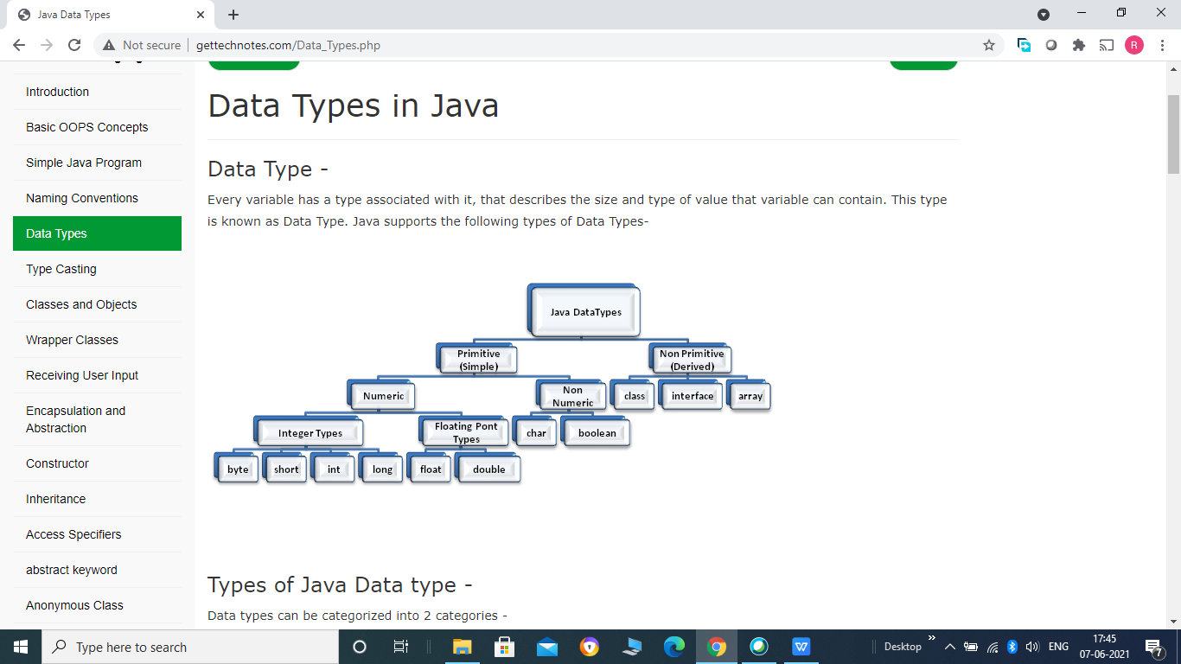
Data Types in Java
Every variable has a type associated with it, that describes the size and type of value that variable can contain. This type is known as Data Type. Java supports the following types of Data Types-

Slide 3
Types of Java Data type -
Data types can be categorized into 2 categories -
1. Primitive Data types
2. Non Primitive Data types
1. Primitive Data types -
Java defines 8 primitive data types - byte, short, int, long, float, double, char and boolean.
Integer Types -
Java support 4 integers types- byte, short, int and long all are signed integers i.e. can store both positive and negative values. Java does not support unsigned integers.
Type Size Value Range
byte 1 byte -128 to 127
short 2 byte -32,768 to 32,767
int 4 byte -2,147,483,648 to 2,147,483,647
long 8 byte -9,223,372,036,854,775,808 to 9,223,372,036,854,775,807

Slide 4
Example -
public class Demo2
{
public static void main(String[] args)
{
byte a = 10;
short b = 20;
int c= 30;
long d = 40l;
//Note we use lower case 'l' to denote a long value
System.out.println("value of a:"+a);
/* '+' is used to concatenate something with any string
and make a new string */
System.out.println ("value of b:"+b);
System.out.println ("value of c:"+c);
System.out.println ("value of d:"+d);
}
}

Slide 5
Floating Point Types -
Java supports 2 floating point data types - float and double. For number containing fractional part we use these data types.
Type Size Value Range
float 4 byte 3.4e+038 (positive or negative)
double 8 byte 1.7e+308 (positive or negative)
Characters Type -
To store character java support char data type. In java char is 2 byte Unicode character that defines fully international character set that can represent all of the characters found in all human languages.
We can also perform arithmetic operations on characters, char can be thought of integer type.

Slide 6
Example -
public class Demo4
{
public static void main(String[] args)
{
char ch1, ch2, ch3, ch4;
ch1 = 'A';
ch2 = 'B';
ch3 = 65; // ASCII value of A
System.out.println("values of ch1, ch2 and ch3 are:"+ch1+" "+ch2+" "+ch3);
ch1++;
ch4 = ch1;
int a = ch1+ch2;
System.out.println("values of ch4 and a are:"+ch4+" "+a);
}
}

Slide 7
Boolean Type -
To support Boolean values (true or false) java provides 'boolean' data type. It require only 1 bit to store boolean value in memory.
Note :- we cannot use 0 for false and non zero value as true in java, as in C or C++.
2. Non Primitive Data types -
There are several non primitive data types supported by java like class, interface etc. These will be covered next.

Slide 8
Class and Object in detail -
As java is an object oriented programming language, everything should be within the class. A class is nothing but a collection of variables (also called fields or data) and methods (functions).
Variables define state and methods define the behaviour.
A class is act as a template (for example - employee) and object as instance (for example - John, Tom etc.) of that template.
Or we can say that class is a collection of objects of similar types (for example ? employee class can have objects like John, Tom etc but not tiger, mango etc.
General Form of Class -
A class is declared using the keyword "class" followed by the user defined class name.

Slide 9
class Class_Name
{
datatype variable 1;
datatype variable 2;
.
.
datatype variable n;
access_specifier return_type method_Name(parameters...)
{
//body of method
}
.
.
access_specifier return_type method_Name(parameters...)
{
//body of method
}
}

Slide 10
A class can have any number of variables and methods.
Variables are called the instance variable because a new copy of these variables is created each time a new instance (object) of class created.
No memory is allocated for instance variables.
Collectively variables and methods are called the members of the class.

Slide 11
Example -
class Employee
{
int id;
String name;
int salary;
float tax;
public void showData()
{
System.out.println(id+" "+name+" "+salary+" "+tax);
}
}

Slide 12
As we already know class does not exist physically, only objects exist physically. So by defining Employee class we only create a template and that does nothing until we create objects of that class.
Object of a class can be created as follows -
Class_Name object_name = new Class_Name();
So for employee class we can create object as follows -
Employee emp1 = new Employee();
Objects in java are created using the new keyword, It dynamically allocate memory for object and return a reference to that object. The reference is nothing but the address of the object in memory.
Employee emp1; // declaring object

Slide 13
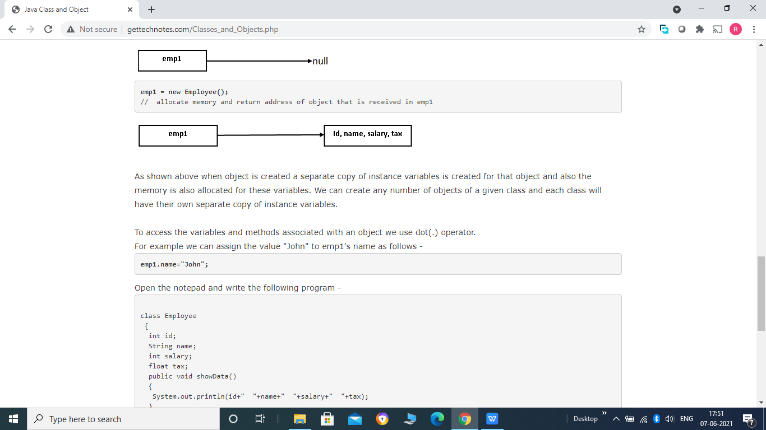
As shown above when object is created a separate copy of instance variables is created for that object
and also the memory is also allocated for these variables. We can create any number of objects of a
given class and each class will have their own separate copy of instance variables.
To access the variables and methods associated with an object we use dot(.) operator.
For example we can assign the value "John" to emp1's name as follows -
emp1.name="John";
Open the notepad and write the following program -

Slide 14
class Employee
{
int id;
String name;
int salary;
float tax;
public void showData()
{
System.out.println(id+" "+name+" "+salary+" "+tax);
}
}
public class Demo
{
public static void main(String args[])
{
Employee emp1 = new Employee();

Slide 15
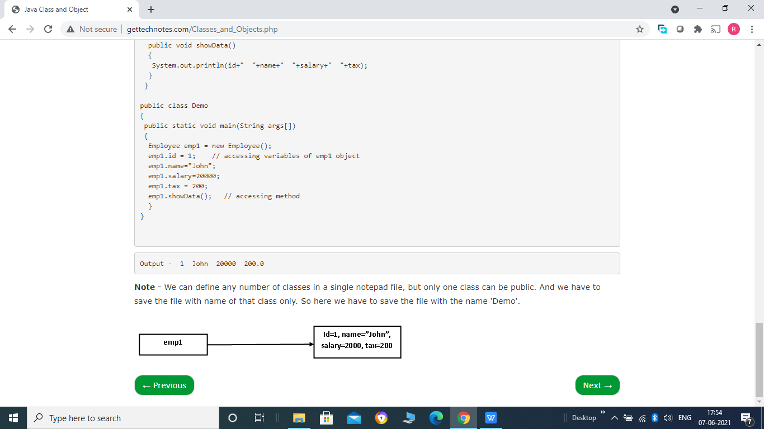
emp1.id = 1; // accessing variables of emp1 object
emp1.name="John";
emp1.salary=20000;
emp1.tax = 200;
emp1.showData(); // accessing method
}
}

Slide 16
Java Wrapper Classes
In java, each of the 8 primitive data type has associated wrapper class. These classes wrap (cover) the value of data type into object of corresponding wrapper class. i.e. primitive data type values can be stored in objects of corresponding wrapper class and vice versa.
Data type Wrapper Class
byte Byte
short Short
int Integer
long Long
float Float
double Double
char Character
boolean Boolean

Slide 17
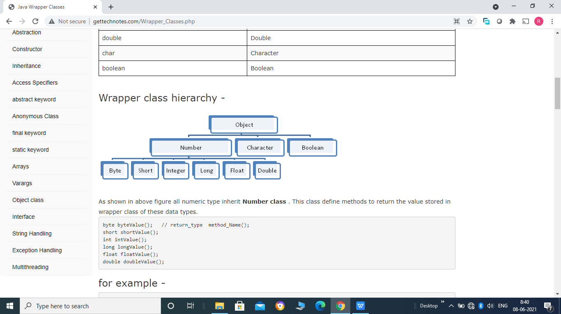

Slide 18
Autoboxing and AutoUnboxing -
Since jdk1.5 java supports the concept of Autoboxing and AutoUnboxing. The process of automatic conversion of primitive data type values into objects of coresponding wrapper class is known as Autoboxing.
For example -
int a=10;
Integer b = a;
And the process of extracting back the value of primitive data type from object type of coresponding wrapper class is known as AutoUnboxing.
For example -
Character ch1 = 'a';
char ch2 = ch1;
So now there is no need to do it manualy, Java automatically does it for you.

Slide 19
Example -
public class Demo
{
public static void main(String args[])
{
Float f1 = 10.12f; // Autoboxing
float f2 = f1; // AutoUnboxing
System.out.println(f1 + " " + f2);
}
}
Output - 10.12 10.12

Slide 20
Converting String into primitive type -
Each of the wrapper classes except Character have a parse() method that is used to convert a valid value of primitive type in string format into corresponding primitive data type.
It is a static method i.e. can be accessed directly by class name without creating any object of the class(static keyword will be covered later in detail). It is defined as follows -
Wrapper Class Parse Method
Byte parseByte("String")
Short parseShort("String")
Integer parseInt("String")
Long parseLong("String")
Float parseFloat("String")
Double parseDouble("String")
Boolean parseBoolean("String")Note -
Here string should be in a valid format that represent primitive type value. Each of the method return corresponding primitive type value.

Slide 21
Example -
public class Demo
{
public static void main(String args[])
{
String s1 = "12";
String s2 = "12.12f";
String s3 = "True";
int a = Integer.parseInt(s1);
//Note static methods can be accessed directly by class name.
float b = Float.parseFloat(s2);
boolean c = Boolean.parseBoolean(s3);
System.out.println("a = "+a+" b = "+b+" c = "+c);
}
}
Output - a = 12 b = 12.12 c = true

Slide 22
Receiving input from user -
Three different methods to take input from user keyboard are as follows -
1- Using readLine() method of java.io.Console class -
It is one of the simplest method to take input from user keyboard added in jdk1.6 using Console class.
Console class has a method named readLine(), which read a complete line and return the value in String format.
As we already know, to access methods of a class we need to create object of the class. We can create object of Console class as follows -
Console c = System.console();
After creating object we can access its readLine() method by using . (period) sign as follows -
s = c.readLine("Enter input");
Or we can combine these lines into one as follows -
String s = System.console().readLine("Enter input");
Note -
We have passed a String parameter in readLine() function and it is optional, if you pass any message then the message will be displayed first and then it takes input value, if you do not pass any message then it directly takes user input.

Slide 23
Example -
Program for the addition of two numbers input by the user -
public class Demo1
{
public static void main(String args[])
{
int a,b,c;
String s1 = System.console().readLine("Enter first number");
a = Integer.parseInt(s1);
/* We can combine above two line into one as follows -
a = Integer.parseInt(System.console().readLine("Eneter first number"));
*/
b = Integer.parseInt(System.console().readLine("Eneter second number"));
c = a+b;
System.out.println("Sum = "+c);
}
}

Slide 24
2.Using java.util.Scanner class -
Scanner class available in java.util package, provides various methods to take input from user keyboard -
Method Description
i. public String nextLine() It reads and returns a complete line at once and moves the Scanner position to next line.
ii. public byte nextByte() It reads and return next input token as byte. An InputMismatchException will be thrown if token cannot be translated into valid byte value or value is out of range of byte.
iii. public short nextShort() It reads and return next input token as short. An InputMismatchException will be thrown if token cannot be translated into valid short value or value is out of range of short.
iv. public int nextInt() It reads and return next input token as int. An InputMismatchException will be thrown if token cannot be translated into valid int value or value is out of range of int.
v. public long nextLong() It reads and return next input token as long. An InputMismatchException will be thrown if token cannot be translated into valid long value or value is out of range of long.
vi. public float nextFloat() It reads and return next input token as float. An InputMismatchException will be thrown if token cannot be translated into valid float value or value is out of range of float.
vii. public double nextDouble() It reads and return next input token as double. An InputMismatchException will be thrown if token cannot be translated into valid double value or value is out of range of double.
viii. public boolean nextBoolean() It reads and return next input token as boolean. An InputMismatchException will be thrown if token cannot be translated into valid boolean value.

Slide 25
So to take input, first create object of Scanner class as follows -
Scanner sc = new Scanner(System.in);
//System.in represents standard input stream typically connected to user keyboard.
Next call any of the method defined in above table, depending upon your needs -
For Example -
int a = sc.netInt(); // To read integer input
String str = sc.nextLine(); // To read a line as String
float b = sc.nextFloat(); // To read float input

Slide 26
Example -
Program for the addition of two numbers input by the user -
import java.util.Scanner;
public class Demo2
{
public static void main(String args[])
{
int a,b,c;
System.out.println("Enter first number");
Scanner sc= new Scanner(System.in);
a = sc.nextInt();
System.out.println("Enter second number");
b = sc.nextInt();
c = a+b;
System.out.println("Sum = "+c);
}
}

Slide 27
3.Using java.io.BufferedReader class -
BufferedReader class available in java.io package, provides readLine() method to take input from user keyboard.
First of all create object of InputStreamReader class -
InputStreamReader isr = new InputStreamReader(System.in);
Next connect this InputStreamReader stream to BufferdReader object -
BufferedReader br = new BufferedReader(isr);
Finally call readLine() method on BufferedReader object -
String str = br.readLine(); // throws IOException
Note - This readLine() method is different from the method we learned in Console class. It cannot have string massage within it. And it also throws IOException.

Slide 28
Example -
Program for the addition of two numbers input by the user -
import java.io.InputStreamReader;
import java.io.BufferedReader;
import java.io.IOException;
public class Demo3
{
public static void main(String args[])throws IOException
{
int a,b,c;
InputStreamReader isr = new InputStreamReader(System.in);
BufferedReader br = new BufferedReader(isr);
System.out.println("Enter first number");
String str1 = br.readLine();
a= Integer.parseInt(str1);

Slide 29
System.out.println("Enter second number");
String str2 = br.readLine();
b = Integer.parseInt(str2);
c = a+b;
System.out.println("Sum = "+c);
}
}
Note - This readLine() throws IOException. So to handle it we made main() method to throws IOException.

